Slide 1

CSET 150
Network Design and Management
Evening Masters Edition
Dr. Mahboob Qaosar
Associate Professor, CSE, RU
Week # 2

Slide 2
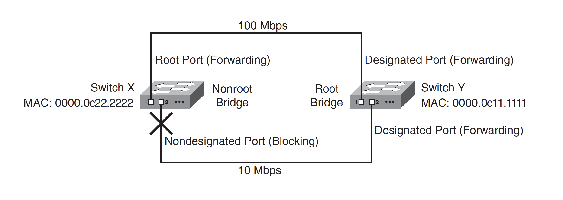
Spanning Tree Protocol

Slide 3
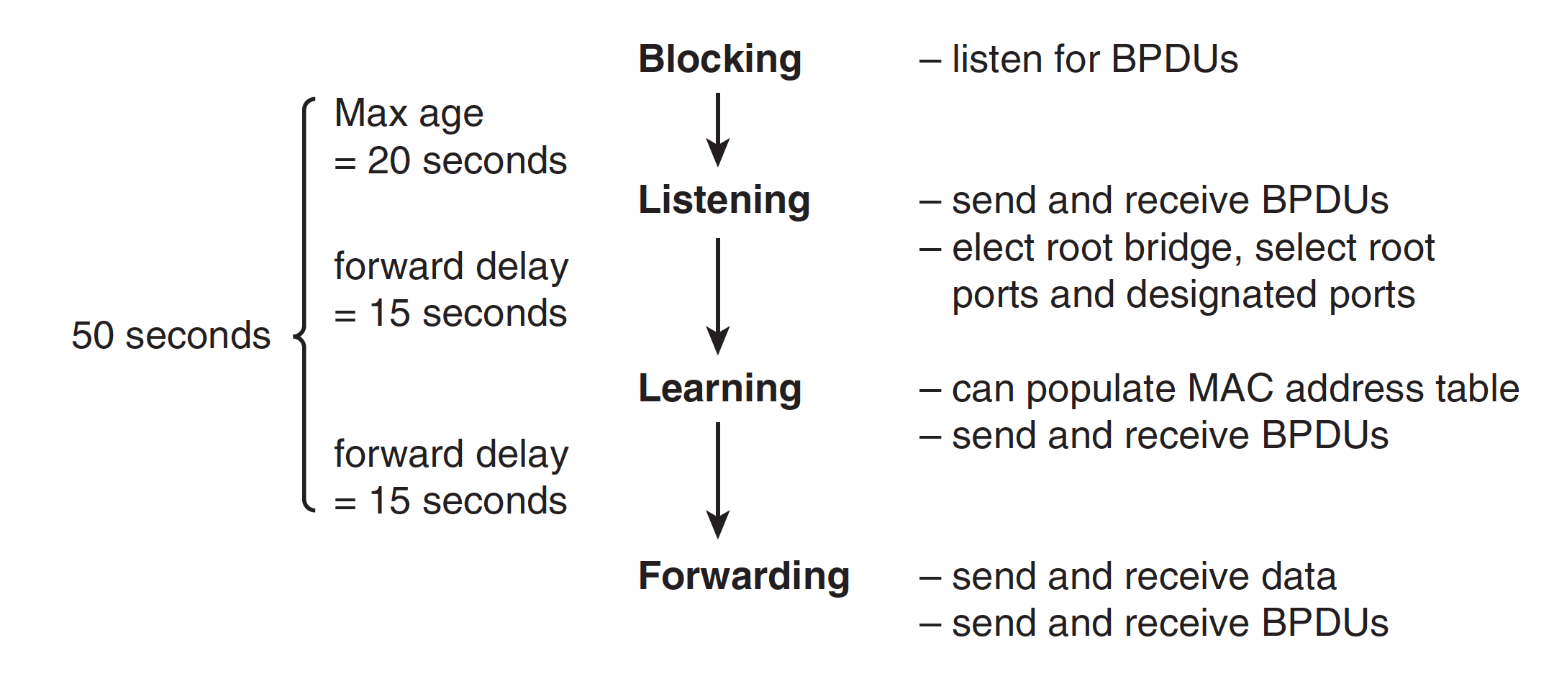
STP States
BPDU: bridge protocol data unit.

Slide 4
Spanning Tree Protocol (STP)
it is put in the blocking state, …. listens for BPDUs and
then transitions to the listening state. (delay 20 seconds).
While in the listening state, the switch can send and receive BPDUs but not data.
The root bridge and the various final states of all the ports are determined in this state.
If the port is chosen as the root port on a switch or as a designated port on a segment, the port transitions to the learning state after the listening state.

Slide 5
Spanning Tree Protocol (STP)
In the learning state, the port still cannot send data, but it can start to populate its MAC address table if any data is received.
The length of time spent in each of the listening and learning states is dictated by the value of the forward-delay parameter, which is 15 seconds by default.
After the learning state, the port transitions to the forwarding state, in which it can operate normally.
Alternatively, if in the listening state the port is not chosen as a root port or designated port, it becomes a nondesignated port and it transitions back to the blocking state.

Slide 6
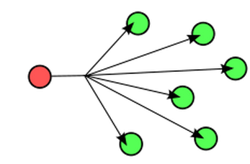
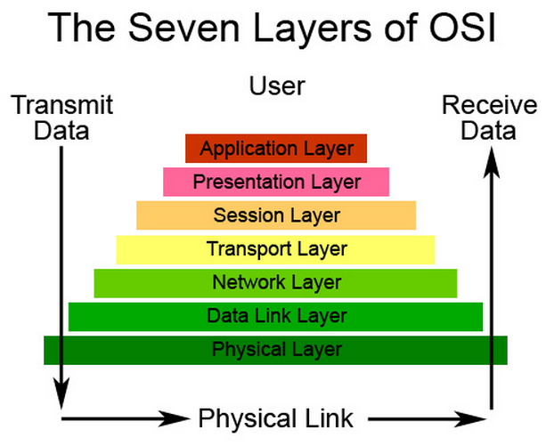
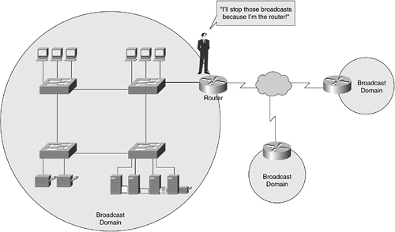
Virtual LANs
Broadcast Domain🡪
All devices that receive each other broadcast.
All devices connected … one port of a router… same broadcast domain
Routers block broadcast packets… by default
Only forward unicast packets and directed broadcast

Slide 7
Virtual LANs
Definition:
A group of devices on one or more LANs that are configured (using management software) so that they can communicate as if they were attached to the same wire, when in fact they are located on a number of different LAN segments. Because VLANs are based on logical instead of physical connections, they are extremely flexible

Slide 8
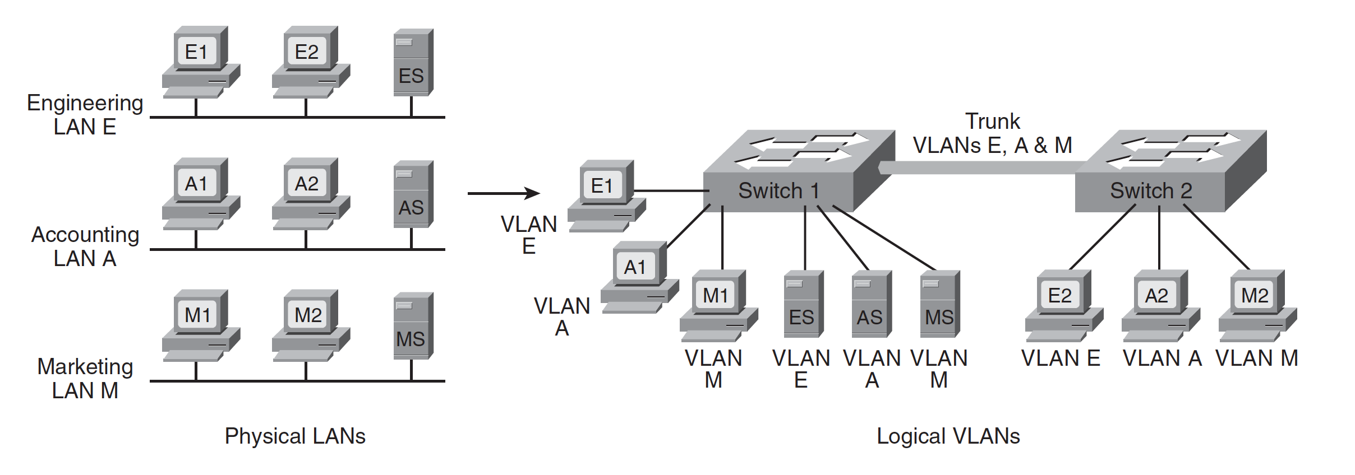
Virtual LANs (2)
Typically, you think of a broadcast domain as being a physical wire, a LAN.
But a broadcast domain can also be a VLAN, a logical construct that can include multiple physical LAN segments

Slide 9
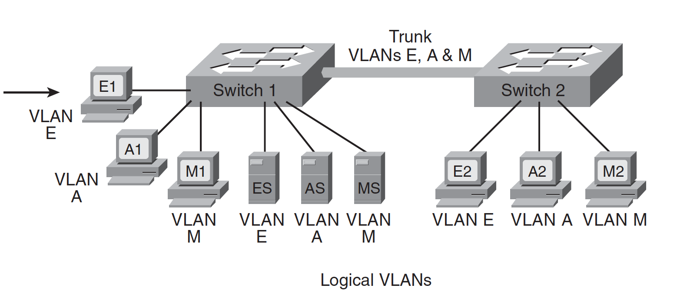
TRUNK
The link between the two switches in the figure carries traffic from all three of the VLANs and is called a trunk
A switch port that is not a trunk can belong to only one VLAN at a time.
You can configure which VLAN a port belongs to in two ways:
statically and dynamically.

Slide 10
STATIC PORT MEMBERSHIP
STATIC PORT MEMBERSHIP means that the network administrator configures which VLAN the port belongs to, regardless of the devices attached to it.
This means that after you have configured the ports, you must ensure that the devices attaching to the switch are plugged into the correct port, and if they move, you must reconfigure the switch.

Slide 11
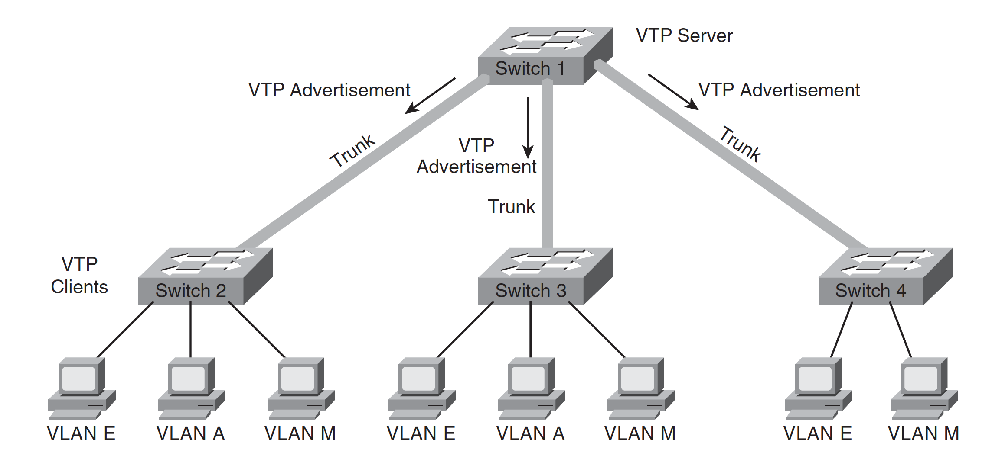
Dynamic VLAN membership
Alternatively, you can configure dynamic VLAN membership.
Some static configuration is still required,
but this time, it is on a separate device called a VLAN Membership Policy Server (VMPS).
The VMPS could be
a separate server, or
it could be a higher-end switch that contains the VMPS information.

Slide 12
VLAN Membership Policy Server (VMPS)
VMPS information consists of a MAC address-to-VLAN map.
Thus, ports are assigned to VLANs based on the MAC address of the device connected to the port.
When you move a device from one port to another port (either on the same switch or on another switch in the network), the switch dynamically assigns the new port to the proper VLAN for that device by consulting the VMPS.

Slide 13
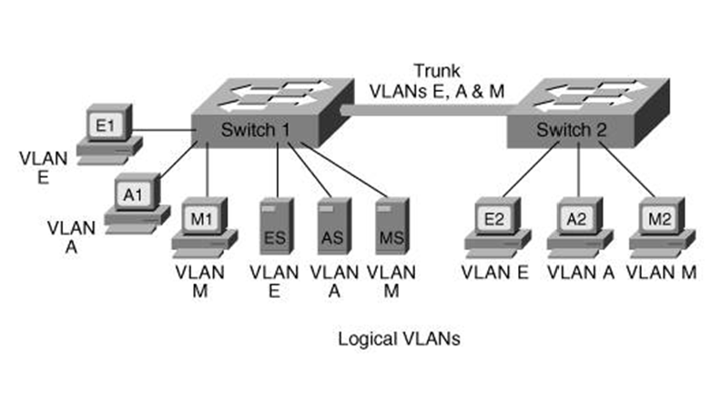
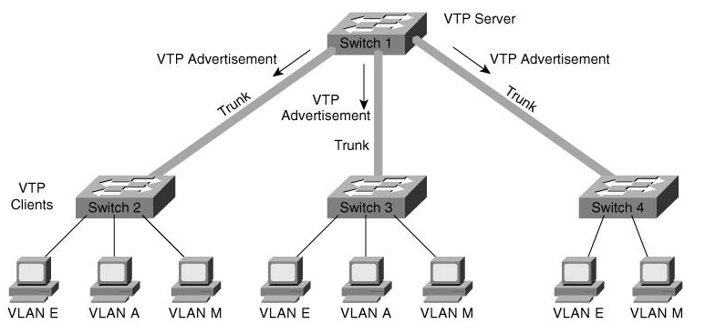
Trunks
A port that carries data from multiple VLANs is called a trunk.
A trunk port can be on a switch, a router, or a server.
A trunk port can use one of two protocols:
Inter-Switch Link (ISL) or IEEE 802.1q.
The two types of trunks are not compatible with each other, so both ends of a trunk must be defined with the same trunk type.

Slide 14
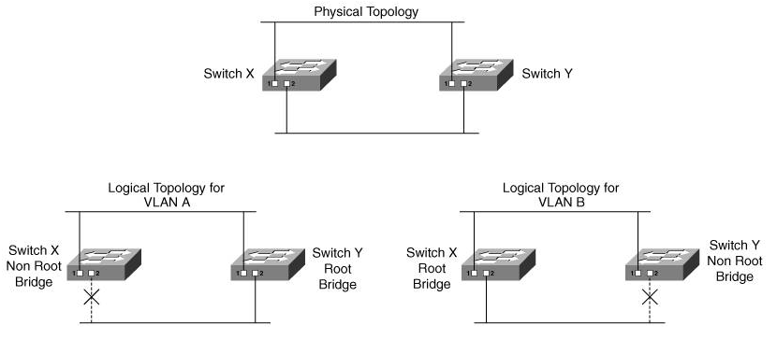
STP and VLANs
Cisco developed per-VLAN spanning tree (PVST) so that switches can have one instance of STP running per VLAN, allowing redundant physical links within the network to be used for different VLANs and thus reducing the load on individual links.

Slide 15
VLAN Trunking Protocol (VTP)
The VLAN Trunking Protocol (VTP) is a Cisco-proprietary Layer 2 protocol that allows easier configuration of VLANs on multiple switches
A switch in a VTP domain (a group of switches communicating with VTP) can be in one of three modes:
server (which is the default mode),
client,
or transparent mode

Slide 16
VLAN Trunking Protocol (VTP)
The VTP server is the one on which you configure the VLANs;
It sends VTP advertisements, containing VLAN configuration information, to VTP clients in the same VTP domain,
VTP advertisements are only sent on trunks.

Slide 17
VLAN Trunking Protocol (VTP)
You cannot create, modify, or delete VLANs on a VTP client;
a VTP client only accepts VLAN configuration information from a VTP server.
A VTP client also forwards the VTP advertisements to other switches.

Slide 18
VLAN Trunking Protocol (VTP)
You can create, modify, or delete VLANs on a switch that is in VTP transparent mode;
This information is not sent to other switches, and the transparent-mode switch ignores advertisements from VTP servers
But does pass them on to other switches.

